Slide 1
STAT7001 – Computing for Practical Statistics 2015 Lecture 2
Exploratory Data Analysis
Dr Franz J. Király

Slide 2
Course organization updates
Workshop assignment
If you have a clash: please go to the non-clashing workshop
If you change workshops: please have the instructors take your name
First In-Course-Assessment
Handing out: Jan 23 (on moodle) Submission: Feb 19, 11:55 pm = Friday midnight of reading week
Groups are randomised (R code on moodle)
Sheet and data available on moodle on Friday
Group randomisation
Group lists available on moodle
Every participant is randomised a group number
People with same group number constitute one group
Use this week to meet and to find a work schedule
Please send us an e-mail if there are any issues

Slide 3
A Guide to Exploratory Data Analysis with R

Slide 4
Exploratory Data Analysis in R
1. Understand your data
What are the contents, variables in your data
How and for which purpose was the data collected
2. Load the data into R
Inspect the data file first: what is the format? Possible errors?
3. Inspection of single variables – of all (if there‘s not too many)
Summary statistics: 5-number summary, mean, variance
Stem-and-leaf display, box-plot, histograms, density plots
4. Bi- and multivariate inspection
Contingency tables, mosaic plot, scatter-plot, Group stratified plots
5. Quantification of the above – always quantify
Association: suitable measures, e.g. covariance, Pearson or rank correlation
Difference: suitable hypothesis tests, e.g. t-test, Wilcoxon signed rank test
Blurred line towards modelling:
Advanced descriptive and predictive models, unspervised learning

Slide 5
Running Example: The Pulse Data
http://statland.org/Software_Help/pulse.htm
You may have been late and had to run to class, but this data is about students running in class. It came from an in-class activity in a college introductory statistics class. Some general data was collected for each student, and then each student was asked to flip a coin. Those whose coin came up heads were asked to run in place for a minute. All students measured their own pulse rate both before and after the running activity took place. Note that the two measurements were made on those who ran and on those who did not. Here are the first seven cases:
PuBefor | PuAfter | Ran | Smokes | Sex | Height | Weight | ActivityL
48 | 54 | no | yes | male | 68.00 | 150 | 0
54 | 56 | no | yes | male | 69.00 | 145 | 2
54 | 50 | no | no | male | 69.00 | 160 | 2
58 | 70 | yes | no | male | 72.00 | 145 | 2
58 | 58 | no | no | male | 66.00 | 135 | 3
58 | 56 | no | no | female | 67.00 | 125 | 2
60 | 76 | yes | no | male | 71.00 | 170 | 3

Slide 6
Running Example: The Pulse Data
http://statland.org/Software_Help/pulse.htm
In addition to the pulse rate before and after the running took place, the data record whether each student ran or not, whether they smoked, their sex, height (in inches), weight (in pounds) and activity level. This last is coded
low/moderate/high
and it is ordered categorical data coded numerically. (The numbers reflect the order but cannot be taken too literally; "moderate" does not mean twice the activity of "low".)
1. Understand your data
Data points = different students
abstract type
R class
Variables:
pulse before
absolute
numeric
pulse after
whether student ran
logical
whether student smokes
logical
student‘s sex
nominal
factor
student‘s height
student‘s weight
absolute
numeric
student‘s activity level
ordinal
ordered

Slide 7
1. Understand your data
does the data contain any cause/effect relationship?
only for those can you say in the end that „variable A causes variable B“!
and even then, you must exercise caution
since the variable might not measure what you think it does
and/or there might be unmeasured influences
… then each student was asked to flip a coin. Those whose coin came up heads were asked to run in place for a minute. All students measured their own pulse rate both before and after the running activity took place. Note that the two measurements were made on those who ran and on those who did not. …
variable ran can influence variable pulse after
there might be other causal relations in „reality“, but not in this data set
since this is the only causality which was designed into the data
Therefore, the pulse data set can not be used to decide:
does sex affect activity level?
does smoking cause higher pulse after?
Statements/questions which are ok are:
etc
do males have higher activity level?
do smokers have higher pulse after?

Slide 8
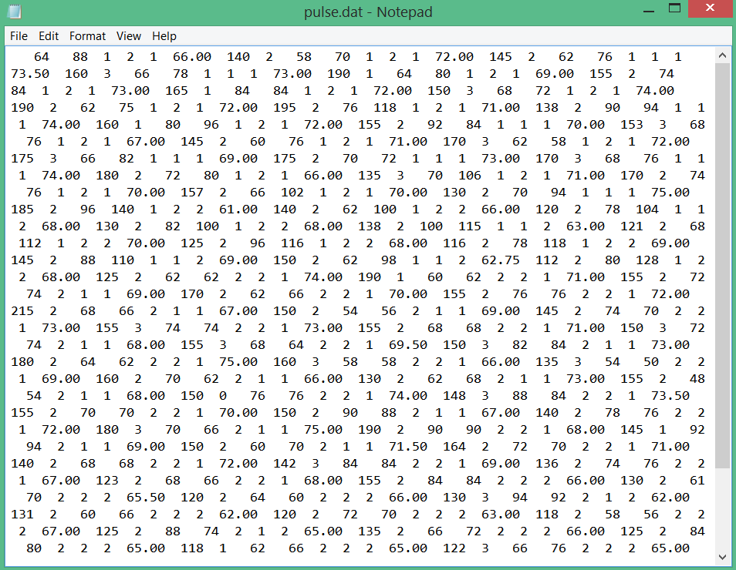
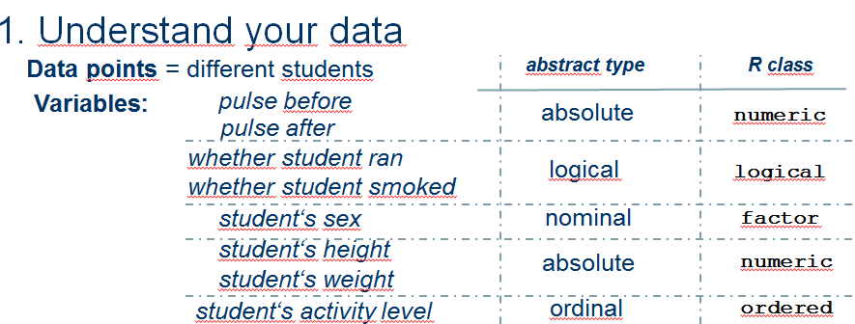
2. Load the data into R
Optimally, you have an exact documentation of the data format
Usually, you don‘t.
Always inspect the data file.
What is 1,2 for logical??
Internet: 2 = false

Slide 9
2. Load the data into R
In the pulse example:
data format is tab delimited, no headers, no line break
all variables are stored as numbers, no matter which type
General characeteristics of data files:
Data order:
row first or column first?
which entries are which variables?
is there a header with variable names?
Data format:
how are the entries stored?
numbers? characters? ASCII? hexadecimal?
fixed length or variable length?
Data separation:
what is between the entries?
tab character? = tab separated
comma? = comma separated / csv
semicolon?
Nothing?
Or enhanced data format where you need to download/ buy importer/converter?

Slide 10
2. Load the data into R
colnamevector <- c("Sex","Age","Name","traininglevel")
colclassvector <- c("factor","numeric","character","ordered")
dataframe <- read.table(file="c:/data.dat", sep = ";" col.names = colnamevector,
colClasses = colclassvector)
put
header = TRUE
if first line contains the column names
strings can be entered as "string" or ‘string‘
cave: use ‘/‘ and not ‘\‘ to avoid problems
In the pulse example:
data format is tab delimited, no headers, no line break
pulsedata <- read.table(file="n:/STAT7001/data/pulse.dat", sep = "",col.names = c("pulsebefore", etc)
colClasses = c("numeric", etc) )
to learn how to load other data types
help(read.table)

Slide 11
2. Load the data into R
In the pulse example:
data format is tab delimited, no headers, no line break
pulsedata <- read.table(file="n:/STAT7001/data/pulse.dat", sep = "",col.names = c("pulsebefore",etc)
colClasses = c("numeric", etc) )
Problem: logical, factor and ordered columns are stored as numeric
naive read command yields type conversion error
Solution: load as numeric/character and then convert to proper variable class
pulsedata$sex<-factor(pulsedata$sex, labels=c("male","female"))
converts column „sex“ to factor (= nominal)
pulsedata$activity<-ordered(pulsedata$activity,levels=0:3, exclude=c(0), labels=c("low","mid","high"))
converts column „activity“ to ordered (= ordinal)
pulsedata[,c("ran","smokes")]<-pulsedata[,c("ran","smokes")]==1
converts columns „ran“ and „smokes“ to logical
Note:
==
Vectorized comparison, yields T if i-th right entry = left entry
<=
<
>=
bigger or equal
>
!=
unequal
smaller or equal
smaller
bigger

Slide 12
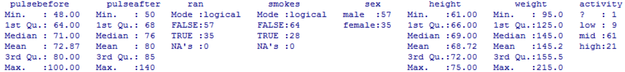
3. Inspection of single variables
First summary overview for tabular data:
summary(pulsedata)
What to look for here?
Does this correspond to the data you wanted to load?
Are all variables there with the right entries?
if not, could be wrong ordering of columns or garbage at the start of the file
Do the ranges and values make sense?
e.g. pulse, height and weight should be numbers; ran/smokes should be logical
a person not in need of acute medical attention has pulse between 30 and 200
an adult would be expected to be between 50 and 100 inches tall
an adult would be expected to weigh between 70 and 400 pounds

Slide 13


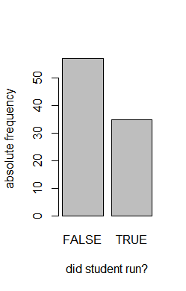
3. Inspection: Logical and nominal variables
summary
displays absolute frequencies for up to 6 values
To get absolute frequencies by variable:
table(pulsedata$ran)
To get relative frequencies by variable:
table(pulsedata$ran)/length(pulsedata$ran)
To get most frequent value:
names(which.max(table(pulsedata$ran)))
Barplot of absolute/relative frequencies:
barplot(table(pulsedata$ran), xlab=…, ylab=…)
barplot(table(pulsedata$ran)/length(…), …)
What to look for here?
Which entries are most/less frequent?
What‘s the general distribution?
the amount of students which didn‘t ran is almost double those who did
the description says a coin was flipped – one would expect sth close to 50/50
5. Quantification:
binom.test
prop.test
Distributional tests

Slide 14

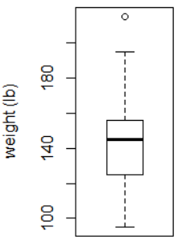
3. Inspection: Continuous variables
summary
displays min, max, quartiles, mean
To get sample mean for one variable
mean(pulsedata$weight)
To get sample variance and standard deviation:
var(pulsedata$weight)
sd(pulsedata$weight)
To get sample quantiles by variable:
quantile(pulsedata$weight)
„outlier“
Boxplot of continuous variable
boxplot(pulsedata$weight, ylab="weight (lb)")
What to look for here?
Where do most data points lie?
What‘s the general distribution?
is the distribution symmetric or skew? Are there lots of outliers?
compare meadian with mean, variance with quantile distances

Slide 15
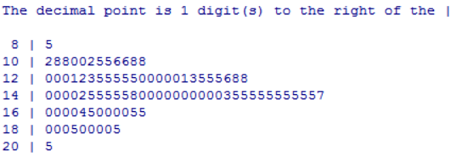
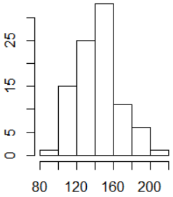
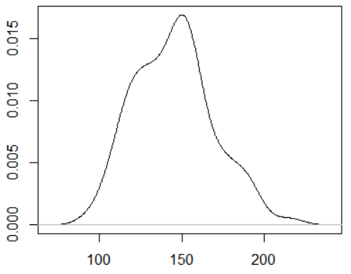
3. Inspection: Continuous variables
Stem-and-leaf display
stem(pulsedata$weight)
equidistant bins „stems“
What to look for here?
quantiles vs distribution vs digits
data points „leaves“ represented by decimal
Histogram
Density plot
Histogram (&stem-and-leaf) is always accurate
Density plot is inexact, depends on bandwith and kernel
bw = …, kernel = …
Box width of histogram can skew „true density“ due to random clustering
Look at all of these to avoid either type of error
hist(pulsedata$weight, breaks = c(etc),xlab= etc, etc)
plot(density(pulsedata$weight),xlab= etc, etc)
What to look for here in all the above?
General distribution:
Symmetry, skewness, number of modes, outliers, qq-plots
5. Quantification:
ks.test
shapiro.test
Distributional tests

Slide 16
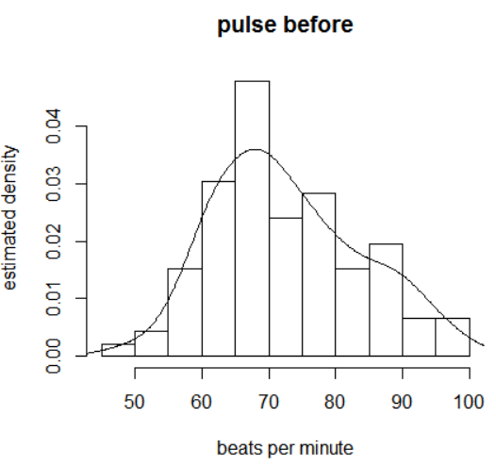
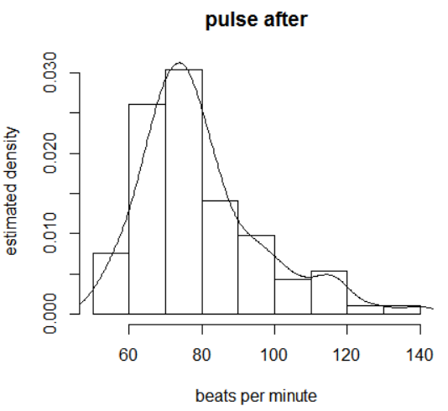
Examples of distribution features
hist(pulsedata$pulsebefore, probability = T, etc)
lines(density(pulsedata$pulsebefore))
Mode = highest peak
second peak?
???
is this bimodality = two peaks?
big Gaussian + small Gaussian?
is there a subgroup which „moves to the right“ after running?
or is this just outliers, or some systematic error?
compare meadian with mean, variance with quantile distances

Slide 17


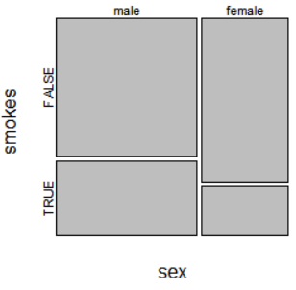
4. Inspection of multiple variables: discrete vs discrete
To get the contingency table:
table(pulsedata[,c("sex","smokes")])
To get a relative frequency table:
prop.table(table(pulsedata[,c("sex","smokes")]))
Mosaic plot of absolute/relative frequencies:
mosaicplot(table(pulsedata[,c("sex","smokes")]))
What to look for here?
Are there differences between the groups?
it appears that less of the females smoke
5. Quantification: are groups different?
Pearson‘s Chi²-test
chisq.test
Fisher‘s exact test
fisher.test
Mantel-Haenszel-test
mantelhaen.test
(independence tests)

Slide 18


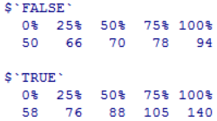
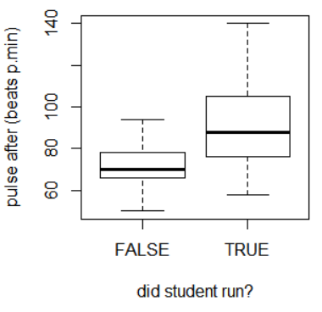
4. Inspection of multiple variables: discrete vs continuous
To get sample mean for one variable, stratified by group
tapply(pulsedata$pulseafter,pulsedata$ran,mean)
To get sample variance and standard deviation:
tapply(pulsedata$pulseafter,pulsedata$ran,sd)
To get sample quantiles by variable:
tapply(etc, etc,quantile)
Boxplot of variable stratified by group(s)
boxplot(pulsedata$pulseafter~pulsedata$ran, etc)
with(pulsedata,boxplot(pulseafter~ran*sex), etc)
What to look for here?
Do characteristics change for group?
If yes, how?
Does the mean/median wander? Does variance/quantile spread/narrow?
Running maybe causes increase in mean/median, spread in variance/quantiles
5. Quantification: are groups different?
Student‘s t-test
t.test
Wilcoxon signed rank test
wilcox.test
Kruskal-Wallis test
Kolmogorov-Smirnov test
kruskal.test
ks.test

Slide 19
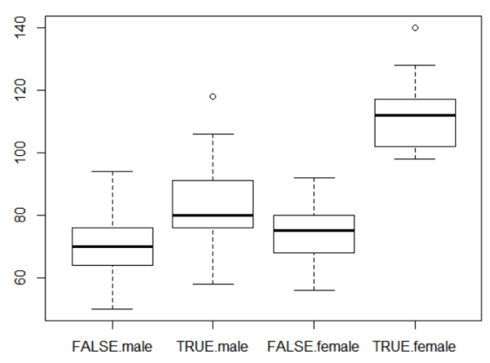
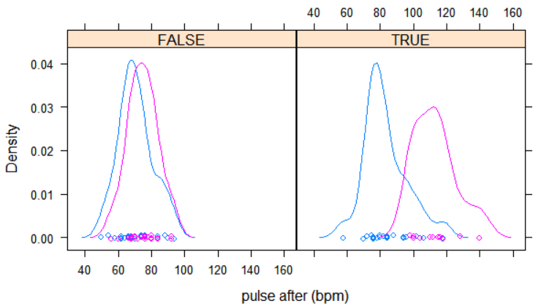
4. Inspection of multiple variables: discrete vs continuous
Boxplot of variable stratified by multiple groups
with(pulsedata,boxplot(pulseafter~ran*sex), etc)
Cave: too many subgroups
make individual groups too small
Density of variable stratified by multiple groups
library(lattice)
with(pulsedata, densityplot (~pulseafter|ran, groups=sex, etc) )
What to look for here?
Subgroup-differences
shape, mean, spread, …
running „splits“ males and females

Slide 20

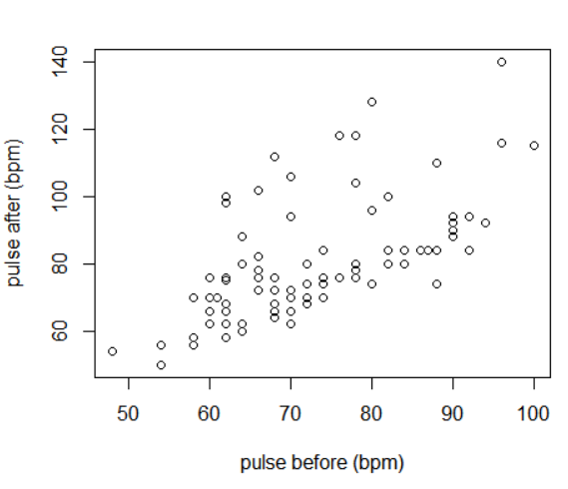
4. Inspection of multiple variables: continuous vs continuous
To get (co)variances:
var(pulsedata[,c("pulsebefore","pulseafter", etc)])
Scatterplot of two variables
plot(pulsedata[,c("pulsebefore","pulseafter")])
plot(pulsedata$pulsebefore,pulsedata$pulseafter)
What to look for here?
Look for general patterns!
What is the general „trend“ in the data?
Does it look „Gaussian“, skew, symmetric?
?
Are there multiple subgroups/clusters?
Are there outliers?
Is there nonlinear behavior?
Two „linear clusters“?
…

Slide 21
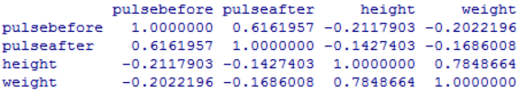
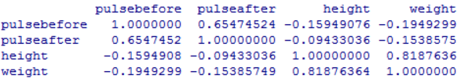
5. Quantification: measures of association
Correlation coefficients
Pearson correlation only for numerical data
cor(pulsedata[,c("pulsebefore","pulseafter", etc)])
Spearman or Kendall rank correlation for ordinal data
cor(pulsedata[etc], method="spearman")
cor(pulsedata[etc], method="kendall")
What to look for here?
Sign of the correlation: positive or negative?
Strength of the correlation: close to 1 or close to 0?
Is there major difference between Pearson/Spearman: nonlinearity?
e.g. the pulse after correlates with pulse before; weight correlates with height
Cave: correlation is not causation!

Slide 22
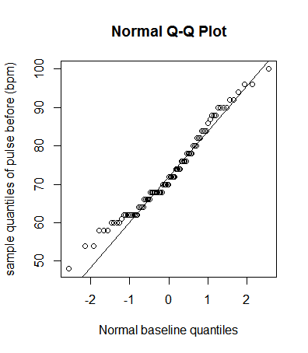
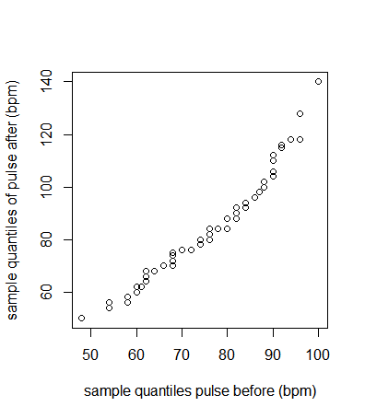
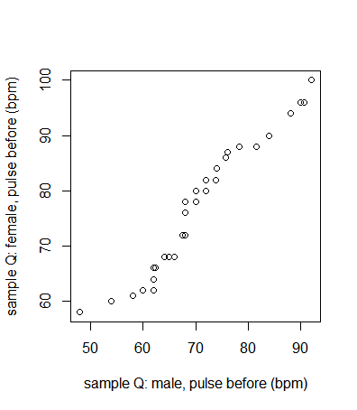
The QQ-plot for
3. assessing quantiles of single variables w.r.t. baseline distribution
4. comparing sample quantiles of two different variables
comparing sample quantiles of one variable in two groups
Normal QQ-plot
qqnorm(pulsedata$pulsebefore, etc)
Baseline QQ-plot
qqplot(etc, distribution = qdistributionname, etc)
(not necessarily normal baseline)
qqline(pulsedata$pulsebefore,etc)
for line
Bivariate QQ-plot
qqplot(pulsedata$pulsebefore, pulsedata$pulseafter,.)
Two-sample QQ-plot
qqplot(group1, group2, etc)
5. Quantification: appropriate version of Kolmogorov-Smirnov
ks.test

Slide 23
Features of the data which need advanced methods

Slide 24
General remarks
Refine your analyses!
the list is not a strict one-way-recipe
return to earliear stages when needed
Use common sense!
Try to fix problems you see!
correct skewness or non-linearity by transformations if necessary
remove outliers for outlier-sensitive analyses or if clearly faulty data
for identified clusters, perform analyses separately for each cluster
refine target variables if necessary (e.g. pulseafter – pulsebefore)
Do not jump to conclusions too early!
if not in the experimental setup, avoid stating mechanisms/causalities
when asking question, make sure the analysis can prove you wrong
Use common sense!
And use knowledge on how your common sense can be mislead.

Slide 25
6. Write up your results!
Summarize data, experiments, findings, interpretation
Suggested structure:
Top of your report: summary/abstract
Interpretation/recommendation, if applicable
Relation to prior analysis/literature - not needed for ICA
but otherwise mandatory!
Description of your data: variables, structure, acquisition, cite source (study or project)
Description of your analysis: questions, numbers, outcomes
Interpretation of your results, discussion and outlook
Appendix: description of file structure, code location, repository of results
attach your code and analyses for reproducibility (e.g. as a file on CD)

Slide 26
Next Week: Linear Models
How to find and interpret linear structure in data

Slide 27
Week 2 Learning Objectives
Further study of R
Understanding data frames, subindexing, assignment
Syntax for loading data and variable classes
Functions for summary statistics and EDA
Exploratory data analysis
Performing basic analysis and interpreting them
Searching for and identifying relationships
Identifying features and problems:
Skewness, clusters, outliers, non-linearity, …
Try it out for yourself on actual data sets

